Slide 1


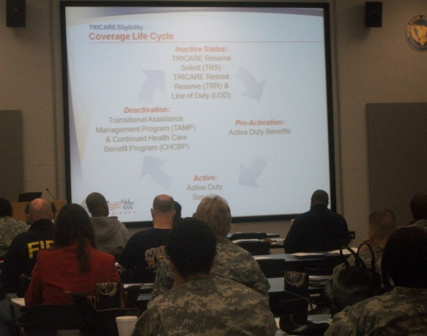
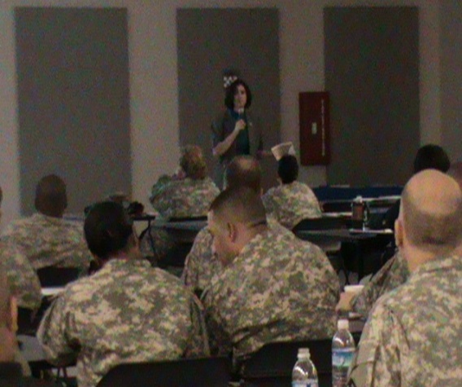
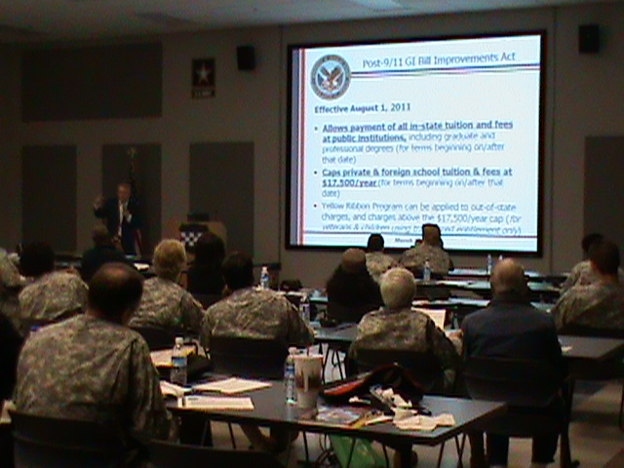
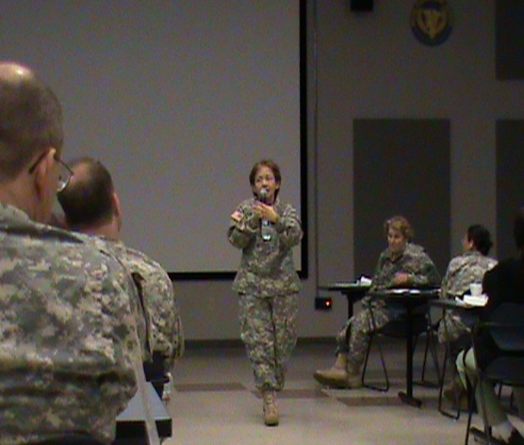
Pre-Retirement Training Brief Event
July 13/14, 2013;0800-1700
Fort Shafter Flats, HI
Building 1554
Are you unsure of what benefits are available to you while waiting to receive retired pay? Do you have questions about the retirement process? If this is YOU…this seminar can answer those questions and more.
Register at: https:einvitations.afit.edu/inv/anim.cfm?i=155850&k=036447017E57
Any questions, please contact: 9th MSC: (808) 438-1600x3194,
HIARNG Retirement section at (808) 844-6291, or
63rd RSC Retirement Services Office at (650) 526-9512/9513
Presenters from Military Service Centers, Veterans Affairs and various Military
Transition Organizations will cover important retirement information from the Reserve perspective:
TRICARE/Dental Options
VA Benefits
Educational Benefits
RC Survivor Benefit Plan

