Slide 1
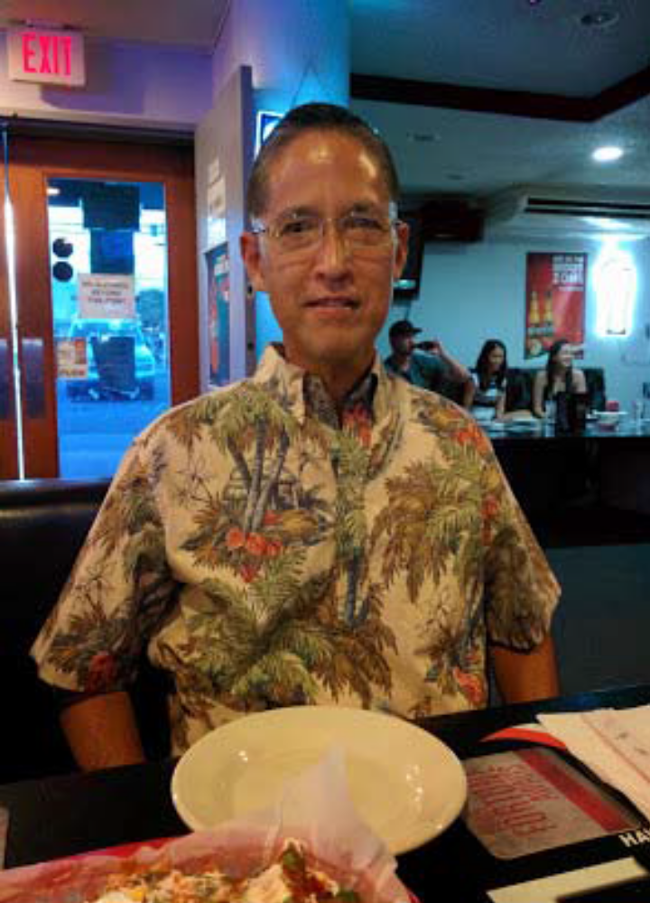

Please Come and Celebrate
Lt Col Dennis Matsuura’s Retirement
10 Nov 14
Natsunoya Tea House
1730-1830 Pupus
1830-2100 Dinner and Program
COST - $40/Deadline 15 Oct 14
POC: (Hickam) Lt Col Gaye Araki: 448-8146 ext 444-6325
(NGAUS) Lt Col Dana Fisher: 655-7211
(HIRAOC) SMSgt Ted Pablo: 655-7211

